Slide 1
WHAT IS A COMPILER?
A program that reads a program written in one language and translates it into another language.
Source language Target language
Traditionally, compilers go from high-level languages to low-level languages.

Slide 2
A compiler is a program that translates (or compiles) a program written in a high-level programming language (the source language) that is suitable for human programmers into the low-level machine language (target language) that is required by computers.
During this process, the compiler will also attempt to spot and report obvious programmer mistakes that are detected during the translation process.

Slide 3
Why we use high-level language for programming?
Using a high-level language for programming has a large impact on how fast programs can be developed. The main reasons for this are:
Compared to machine language, the notation used by programming languages is closer to the way humans think about problems.
The compiler can spot some obvious programming mistakes.
Programs written in a high-level language tend to be shorter than equivalent programs written in machine language.
The same program can be compiled to many different machine languages and, hence, be brought to run on many different machines.

Slide 4
Compilers and Interpreters
“Compilation”
Translation of a program written in a source language into a semantically equivalent program written in a target language
Input
Source
Program
Compiler
Target
Program
Error messages
Output

Slide 5
COMPILER ARCHITECTURE
In more detail:
Intermediate
Language
Front End –
language specific
Back End –
machine specific
Source
Language
Target Language
Separation of Concerns
Retargeting

Slide 6
COMPILER ARCHITECTURE
Intermediate
Language
Intermediate
Language
Source
language
Scanner
(lexical
analysis)
Parser
(syntax
analysis)
Semantic
Analysis
(IC generator)
Code
Optimizer
Code
Generator
Target
language
tokens
Syntactic
structure
Symbol
Table

Slide 7
COMPILATION PROCESS
The compilation process details the stages a source program goes through to produce machine-executable code. Below is a detailed explanation of each stage

Slide 8
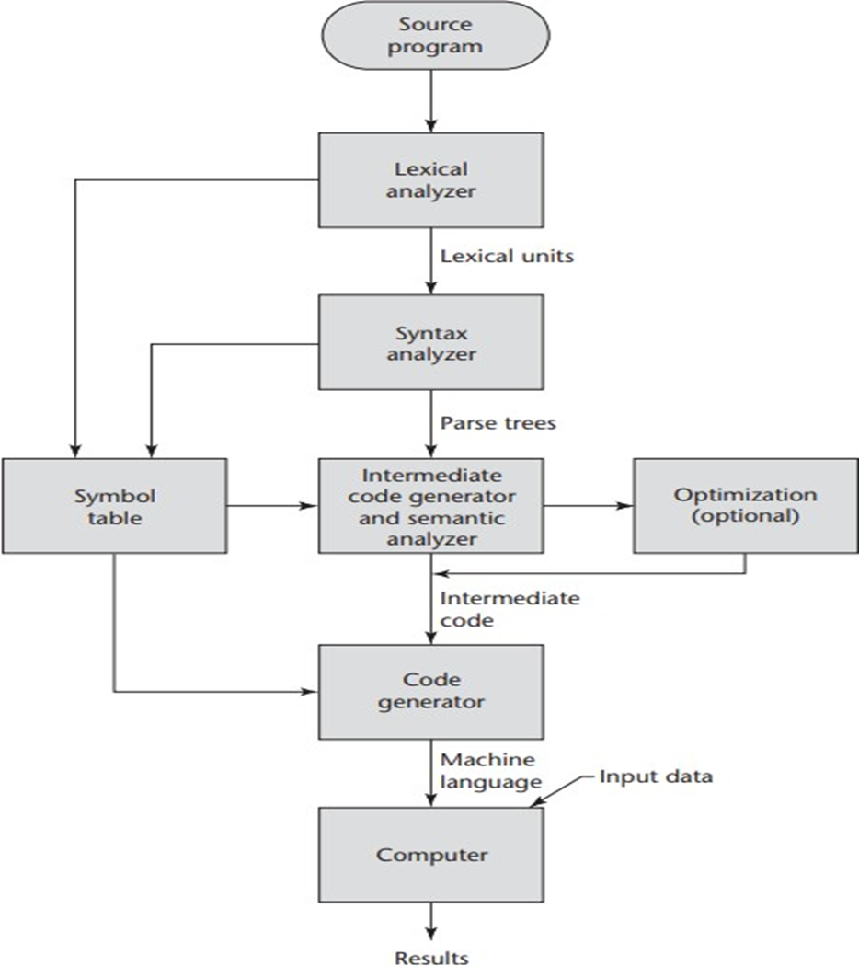
Outline of the compilation process

Slide 9
1. Source Program
This is the input written in a high-level programming language (e.g., C, Java, or Python) that needs to be compiled into machine code.

Slide 10
2. Lexical Analyzer
Breaks down the source program into lexical units (tokens), such as keywords, operators, identifiers, and literals.
Tokens that represent the basic syntax elements of the source program.
Example: The statement int a = 5; would be broken into tokens like int, a, =, 5, and ;.
Detects lexical errors such as invalid characters in the source program.

Slide 11
Input: result = a + b * c / d
Tokens:
‘result’, ‘=‘, ‘a’, ‘+’, ‘b’, ‘*’, ‘c’, ‘/’, ‘d’
Identifiers
Operators

Slide 12
3. Syntax Analyzer
Analyzes the structure of the program using the tokens from the lexical analyzer.
A parse tree, which represents the hierarchical structure of the source code according to the grammar of the language.
Identifies syntax errors, such as missing parentheses or incorrect statement structure.
Ensures if (a > b) is correctly structured.

Slide 13
Input: result = a + b * c / d
Exp ::= Exp ‘+’ Exp
| Exp ‘-’ Exp
| Exp ‘*’ Exp
| Exp ‘/’ Exp
| ID
Assign ::= ID ‘=‘ Exp
Assign
ID ‘=‘ Exp
Exp ‘+’ Exp
ID
Exp ‘*’ Exp
ID
Exp ‘/’ Exp
ID
ID

Slide 14
Input: result = a + b * c / d
The expression part is broken down considering operator precedence: Multiplication (*) and division (/) are evaluated before addition (+). Division (/) has the same precedence as multiplication and is evaluated left to right
The tree reflects operator precedence and associativity. It shows how a compiler breaks the expression into a syntax tree for further analysis. This structure helps generate intermediate code or perform semantic checks.

Slide 15
4. Symbol Table
Maintains a record of all identifiers (e.g., variables, functions) used in the program, along with their attributes such as type, scope, and memory location.
Updated and accessed throughout the compilation process to ensure consistency and resolve references.

Slide 16
5. Intermediate Code Generator and Semantic Analyzer
Semantic Analyzer:
Ensures that the program's logic and semantics are correct (e.g., type compatibility in assignments).
Example: Verifies if adding a string and an integer is valid.
Intermediate Code Generator:
Produces an intermediate representation (IR) of the program, which is closer to machine code but still abstract.
Example: Converts a = b + c; into intermediate code like ADD b, c -> a.
Intermediate code, simplifies optimization and code generation.

Slide 17
Semantic Analysis
Syntactic/semantic
structure
Syntactic
structure
Source
language
Scanner
(lexical
analysis)
Parser
(syntax
analysis)
Semantic
Analysis
(IC generator)
Code
Generator
Target
language
Syntactic/semantic
structure
Code
Optimizer
“Meaning”
Type/Error Checking
Intermediate Code Generation – abstract machine
Symbol
Table

Slide 18
6. Optimization (Optional)
Improves the efficiency of the intermediate code by:
Reducing redundant computations.
Minimizing resource usage (e.g., memory and CPU).
Example: If the value of a variable does not change, redundant recalculations are removed.

Slide 19
Optimization
Source
language
Scanner
(lexical
analysis)
Parser
(syntax
analysis)
Semantic
Analysis
(IC generator)
Code
Generator
Target
language
Syntactic/semantic
structure
Syntactic/semantic
structure
Code
Optimizer
Symbol
Table
Improving efficiency (machine independent)
Finding optimal code is NP

Slide 20
7. Code Generator
Translates the optimized intermediate code into machine language or assembly code, specific to the target architecture.
Low-level machine code that can be executed by the computer's CPU.
Example: Converts intermediate operations into specific assembly instructions like MOV, ADD, and STORE.

Slide 21
Code Generation
Syntactic/semantic
structure
Source
language
Scanner
(lexical
analysis)
Parser
(syntax
analysis)
Semantic
Analysis
(IC generator)
Code
Generator
Target
language
Syntactic/semantic
structure
Code
Optimizer
IC to real machine code
Memory management, register allocation, instruction selection, instruction scheduling, …
Symbol
Table

Slide 22
8. Computer
Machine code and user-provided inputs are executed on the hardware.
Produces the final result of the program, such as computations, file manipulations, or visual outputs.

Slide 23
Summary of Error Detection and Handling:
Lexical Errors: Detected during tokenization (e.g., invalid symbols).
Syntax Errors: Identified by analyzing the parse tree structure.
Semantic Errors: Found during the semantic analysis (e.g., type mismatches).
Runtime Errors: Not addressed in the compilation process but handled during execution.

Slide 24
The Phases of a Compiler
Phase | Output | Sample
Programmer | Source string | A=B+C;
Scanner (performs lexical analysis) | Token string | ‘A’, ‘=’, ‘B’, ‘+’, ‘C’, ‘;’ And symbol table for identifiers
Parser (performs syntax analysis based on the grammar of the programming language) | Parse tree or abstract syntax tree | ; | = / \ A + / \ B C
Semantic analyzer (type checking, etc) | Parse tree or abstract syntax tree
Intermediate code generator | Three-address code, quads, or RTL | int2fp B t1 + t1 C t2 := t2 A
Optimizer | Three-address code, quads, or RTL | int2fp B t1 + t1 #2.3 A
Code generator | Assembly code | MOVF #2.3,r1 ADDF2 r1,r2 MOVF r2,A
Peephole optimizer | Assembly code | ADDF2 #2.3,r2 MOVF r2,A

Slide 25
Preprocessors, Compilers, Assemblers, and Linkers
Skeletal Source Program
Preprocessor
Source Program
Compiler
Try for example:
gcc -v myprog.c
Target Assembly Program
Assembler
Relocatable Object Code
Linker
Libraries and
Relocatable Object Files
Absolute Machine Code

Slide 26
1. Preprocessor
Input: Skeletal source program (e.g., #include, #define in C)
Action: Handles directives like macro expansion, file inclusion, and conditional compilation.
Output: A complete source program with all preprocessor directives resolved.
Example tool: gcc -E myprog.c

Slide 27
2. Compiler
Input: Preprocessed source code
Action: Translates high-level code (like C, C++) into assembly code.
Output: A target assembly program
Example tool: gcc -S myprog.c

Slide 28
3. Assembler
Input: Assembly code
Action: Converts the assembly language into machine code, specifically a relocatable object file.
Output: Object code (.o/.obj) that isn't fully ready to run
Example tool: as myprog.s -o myprog.o

Slide 29
4. Linker
Input: Object files + libraries
Action: Combines your code with library functions, resolves references, and produces absolute machine code.
Output: An executable file (e.g., .exe, a.out)
Example tool: ld or invoked via gcc

Slide 30
Issues Driving Compiler Design
Correctness
Speed (runtime and compile time)
Degrees of optimization
Multiple passes
Space
Feedback to user
Debugging

Slide 31
Why study compilers?
Bring together:
Data structures & Algorithms
Formal Languages
Computer Architecture
Influence:
Language Design
Architecture (influence is bi-directional)
Techniques used influence other areas (program analysis, testing, …)

Slide 32
INTRODUCTION TO INTERPRETATION
Interpretation involves executing a program without prior translation to machine code.
The interpreter acts as a virtual machine that processes high-level language statements directly.
Unlike compilation, which generates an executable file, the interpreter processes and evaluates source code dynamically at runtime.

Slide 33
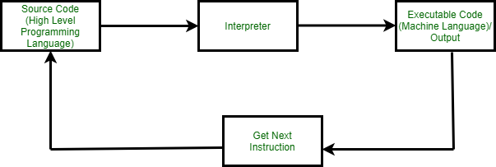

Slide 34
Translation Process in Interpretation
a. Read Phase (Input Analysis)
The interpreter reads a statement or expression from the source program.
The source code is typically parsed into an internal representation, such as an abstract syntax tree (AST) or another intermediate structure, to facilitate evaluation.
Example:
x = 5 + 3
This statement would be broken down into:
A variable x.
An assignment operator =.
An expression 5 + 3 to evaluate.

Slide 35
b. Evaluation Phase
The interpreter evaluates the internal form of the statement.
The interpreter traverses the internal representation and computes the result of expressions, performs assignments, or calls functions.
This phase corresponds to the execute cycle in traditional fetch-execute operations of hardware.
Example:
Evaluating 5 + 3 computes the result 8.
The interpreter then binds the result to the variable x.

Slide 36
c. Print Phase
If the statement or expression produces a visible output (e.g., a print statement or a result in a REPL), the interpreter displays it to the user.
Example:
print(x)
Output: 8.

Slide 37
d. Looping (Repeat)
After processing one statement, the interpreter returns to the input phase and reads the next statement or expression.
This cycle (read → evaluate → print → loop) continues until:
There are no more statements.
A specific exit condition (e.g., an exit or quit command) is encountered.
This is commonly referred to as the Read-Eval-Print Loop (REPL).

Slide 38
Example of Read-Eval-Print Loop (REPL)
A Python interpreter follows this process:
Read: The user enters x = 10 + 5.
Evaluate:
The interpreter parses the input.
It computes the expression 10 + 5 to get 15.
Assigns the result to x.
Print: If it is an interactive session (e.g., REPL), the result or status is shown.
Loop: The interpreter waits for the next statement.

Slide 39
Comparison with Compilation
Compilation:
Translates the entire source program into machine code before execution.
Faster execution after compilation.
Errors are detected during compilation, not at runtime.
Interpretation:
Executes statements line by line without producing machine code.
Slower but allows immediate error detection and debugging.

Slide 40
Applications of Interpretation
Scripting languages: JavaScript, PHP, and Python.
Prototyping and dynamic environments: MATLAB or interactive shells.
Web development: Server-side interpretation for web scripts.

Slide 41
Compilers and Interpreters (cont’d)
“Interpretation”
Performing the operations implied by the source program
Source
Program
Interpreter
Output
Input
Error messages

Slide 42
Compiler vs. Interpreter
Compiler
Interpreter
Takes Entire program as input
It is Faster
intermediate object code is generated.
Required more memory Due to intermediate object code
Program not need compile every time
Errors are displayed after entire program is checked.
Debugging is comparatively hard.
Ex: C, C++.
Take single instruction as input
It is Slower
No intermediate code is generated
Required less memory As no intermediate code is generated
Every time higher level program is converted into lower level program.
Errors are displayed for every instruction interpreted.
Debugging is easy.
Ex: python, Ruby, basic.

Slide 43
Hybrid compiler
Compilation and interpretation may be combined to implement a programming language:
The compiler may produce intermediate-level code, which is then interpreted rather than compiled to machine code.
Ex: java
Source Program
Translator
(Compiler)
Intermediate Program
Virtual machine
(Interpreter)
Output
Input

Slide 44
The Analysis-Synthesis Model of Compilation
There are two parts to compilation:
Analysis determines the operations implied by the source program, which are recorded in a tree structure
Synthesis takes the tree structure and translates the operations therein into the target program

Slide 45
Other Tools that Use the Analysis-Synthesis Model
Editors (syntax highlighting)
Pretty printers (e.g. doxygen)
Static checkers (e.g. lint and splint)
Interpreters
Text formatters (e.g. TeX and LaTeX)
Silicon compilers (e.g. VHDL)
Query interpreters/compilers (Databases)

Slide 46
Compiler-Construction Tools
Parser generators that automatically produce syntax analyzers from a grammatical description of a programming language.
2. Scanner generators that produce lexical analyzers from a regular-expression description of the tokens of a language.
3. Syntax-directed translation engines that produce collections of routines for walking a parse tree and generating intermediate code.

Slide 47
Compiler-Construction Tools
4. Code-generator generators that produce a code generator from a collection of rules for translating each operation of the intermediate language into the machine language for a target machine.
5. Data-flow analysis engines that facilitate the gathering of information about how values are transmitted from one part of a program to each other part. Data-flow analysis is a key part of code optimization.
6. Compiler-construction toolkits that provide an integrated set of routines for constructing various phases of a compiler.

Slide 48
Why learn about compilers?
It is considered a topic that you should know in order to be “well-cultured” in computer science.
A good craftsman should know his tools, and compilers are important tools for programmers and computer scientists.
The techniques used for constructing a compiler are useful for other purposes as well.
There is a good chance that a programmer or computer scientist will need to write a compiler or interpreter for a domain-specific language.

Slide 49
The Evolution of Programming Language
Classification by generation
First-generation languages: machine languages
Second-generation : assembly languages
Third-generation : higher-level languages like Fortran, Cobol, Lisp, C, C++, C#, and Java.
Fourth-generation languages: languages designed for specific applications like NOMAD for report generation, SQL for database queries, and Postscript for text formatting.
fifth-generation language has been applied to logic- and constraint-based languages like Prolog and OPS5.

Slide 50
Impacts on Compilers
The advances in programming languages placed new demands on compiler writers.
Compiler writers would take maximal advantage of the new hardware capabilities.
Good software-engineering techniques are essential for creating and evolving modern language processors.
Notes:
The design of programming languages and compilers are intimately related, the advances in programming languages placed new demands on compiler writers. They had to devise algorithms and representations to translate and support the new language features.
Since the 1940's, computer architecture has evolved as well. Not only did the compiler writers have to track new language features, they also had to devise translation algorithms that would take maximal advantage of the new hardware capabilities.
Compilers can help promote the use of high-level languages by minimizing the execution overhead of the programs written in these languages.
Compilers are also critical in making high-performance computer architectures effective on users' applications. In fact, the performance of a computer system is so dependent on compiler technology that compilers are used as a tool in evaluating architectural concepts before a computer is built.
Compiler writing is challenging. A compiler by itself is a large program.
Moreover, many modern language-processing systems handle several source languages and target machines within the same framework; that is, they serve as collections of compilers, possibly consisting of millions of lines of code. Consequently, good software-engineering techniques are essential for creating and evolving modern language processors.
A compiler must translate correctly the potentially infinite set of programs that could be written in the source language. The problem of generating the optimal target code from a source program is undecidable in general; thus, compiler writers must evaluate tradeoffs about what problems to tackle and what heuristics to use to approach the problem of generating efficient code.

Slide 51
The Grouping of Phases
Compiler front and back ends:
Analysis (machine independent front end)
Synthesis (machine dependent back end)
Passes
A collection of phases may be repeated only once (single pass) or multiple times (multi pass)
Single pass: usually requires everything to be defined before being used in source program
Multi pass: compiler may have to keep entire program representation in memory

Slide 52
Compiler-Construction Tools
Software development tools are available to implement one or more compiler phases:
Scanner generators
Parser generators
Syntax-directed translation engines
Automatic code generators
Data-flow engines

Slide 53
Summary
Language Processors: An integrated software development environment includes many different kinds of language processors such as compilers, interpreters, assemblers, linkers, loaders, debuggers, profilers.
Compiler Phases: A compiler operates as a sequence of phases, each of which transforms the source program from one intermediate representation to another.
Lexical Analyzer
Syntax Analyzer
Semantic Analyzer
Intermediate Code Generator
Machine-Independent Code Optimizer
Code Generator
Machine-Dependent Code Optimizer
Machine and Assembly Languages: Machine languages were the first generation programming languages, followed by assembly languages. Programming in these languages was time consuming and error prone.

